Slide 1
Lake County Safety Council
Thursday, November 10 Meeting
Back to the Basics:
OSHA Requirements; Ladders & Walking Working Surfaces; Industrial Hygiene; PPE; Respiratory Protection

Slide 2
Event Sponsor
HzW Environmental Consultants

Slide 3
Event Sponsor
Lake Health
Occupational Services

Slide 4
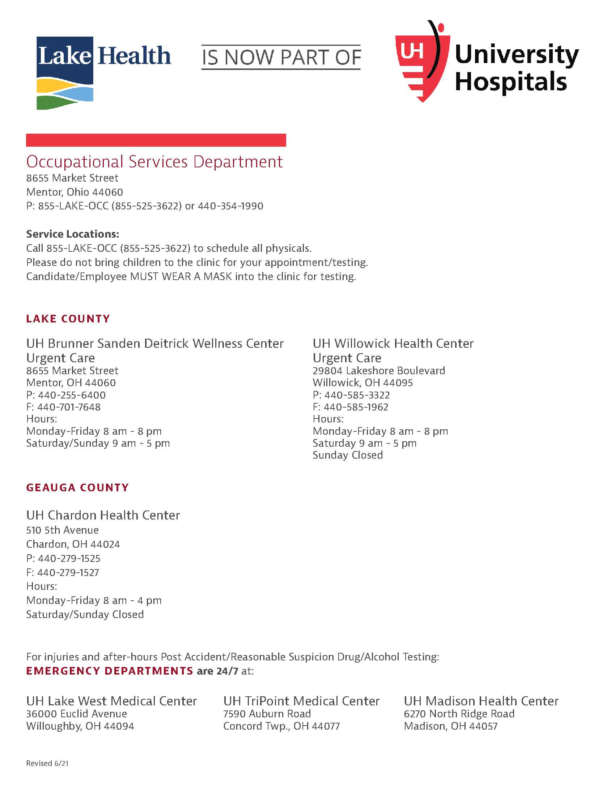
Event Sponsor
Lake Health
Occupational Services

Slide 6
It’s a whole new world
Covid-19 induced turnover
Downsizing workforce
Doubling workforce
New responsibilities for current employees
Limited resources
Lead time shrinkage
Supply chain delays
Cash
Notes:
The majority of businesses in the United States are currently behaving like a new start up business.
Trying to solve staffing problems
Unreliable supply chain causing us all to locate new vendors and spend the nights trying to come up with creative ways to solve production issues.
A year and a half ago we went from 70 miles per hour to 0 within days. Now we are going from 0 to 100 in hours.
Replacement staff has no experience.
Replacement supervisors have little understanding of safety and/or production.
Production needs work NOW! But we are not prepared with basic safety orientation.

Slide 7
Today I’m going to talk about Safety Basics
OSHA
Ladders and Walking Working Surfaces
Industrial Hygiene – noise, chemical ventilation
PPE
Respiratory Protection
Notes:
We don’t have time to get deep in the weeds on any of these topics. But we need to reset our foundation, layout a plan and start getting things under control given the current personnel challenges, business needs and resources constraints.

Slide 8
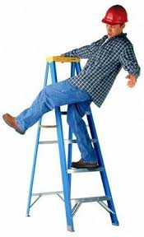
Ladders

Slide 9
Ladders last
Train employees on safe work rules with a portable ladder
Ensure ladders are proper type, rating and condition
Build or utilize permanent platforms

Slide 10
Stairways

Slide 11
Walking and working surfaces

Slide 12
Subpart D requirements
Revised in 2016
More specific criteria for ladders, stairs, dockboards, scaffolds and fall protection
Start with an inventory of what you have
Identify opportunities for changes

Slide 13
Industrial hygiene

Slide 14
noise

Slide 15
Local emphasis program
General noise survey
Hearing Conservation Program
Individual Noise Dosimetry

Slide 16
chemicals

Slide 17
OSHA Top-10
Train new employees
Safety Data Sheets
Labeling and Handling
What to do if…
Notes:
Training new employees
Find SDS
Understand SDS
Labeling
Handling
What to do if…

Slide 18
Heat stress

Slide 19
OSHA Proposed a new nep
OSHA is working to formalize a National Emphasis Program (NEP) and launching rulemaking process on heat hazard cases.
OSHA is working toward the NEP to take effect before the Summer of 2022
Priority on heat related interventions and workplace inspections on days when heat index exceeds 80° F
Notes:
https://www.osha.gov/news/newsreleases/national/09202021

Slide 20
Personal protective equipment

Slide 21
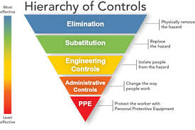
Written certification Training Storage Inspection
Notes:
https://www.osha.gov/laws-regs/regulations/standardnumber/1910/1910.132
The employer shall verify that the required workplace hazard assessment has been performed through a written certification that identifies the workplace evaluated; the person certifying that the evaluation has been performed; the date(s) of the hazard assessment; and, which identifies the document as a certification of hazard assessment.

Slide 22
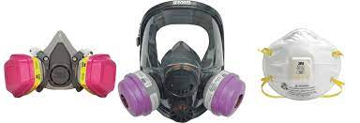
respirators

Slide 23
OSHa requirements
Medical Clearance
Fit Testing
Training
Notes:
Medical Clearance
Use of any respirator required by the employer requires medical clearance.
Voluntary use of a tight-fitting respirator requires medical clearance.
Medical clearance is the obligation of the employer at no cost to the employee.
Fit Testing
Any required use of a respirator
N95’s as well
Not necessary for a loose fitting PAPR
Training
Limitations, storage, cleaning, fit.

